Slide 1
CSSE3113 – Introduction to Software Engineering Software Project Scheduling

Slide 2
Eight Reasons for Late Software Delivery
An unrealistic deadline established by someone outside the software engineering group and forced on managers and practitioners within the group
Changing customer requirements that are not reflected in schedule changes
An honest underestimate of the amount of effort and /or the number of resources that will be required to do the job
Predictable and/or unpredictable risks that were not considered when the project commenced

Slide 3
Eight Reasons for Late Software Delivery
Technical difficulties that could not have been foreseen in advance
Human difficulties that could not have been foreseen in advance
Miscommunication among project staff that results in delays
A failure by project management to recognize that the project is falling behind schedule and a lack of action to correct the problem

Slide 4
Basic Principles for Project Scheduling
Compartmentalization
The project must be compartmentalized into a number of manageable activities, actions, and tasks; both the product and the process are decomposed
Interdependency
The interdependency of each compartmentalized activity, action, or task must be determined
Some tasks must occur in sequence while others can occur in parallel
Some actions or activities cannot commence until the work product produced by another is available
Time allocation
Each task to be scheduled must be allocated some number of work units
In addition, each task must be assigned a start date and a completion date that are a function of the interdependencies
Start and stop dates are also established based on whether work will be conducted on a full-time or part-time basis

Slide 5
Basic Principles for Project Scheduling
Effort validation
Every project has a defined number of people on the team
As time allocation occurs, the project manager must ensure that no more than the allocated number of people have been scheduled at any given time
Defined responsibilities
Every task that is scheduled should be assigned to a specific team member
Defined outcomes
Every task that is scheduled should have a defined outcome for software projects such as a work product or part of a work product
Work products are often combined in deliverables
Defined milestones
Every task or group of tasks should be associated with a project milestone
A milestone is accomplished when one or more work products has been reviewed for quality and has been approved

Slide 6
Relationship Between People and Effort
Common management myth:
If we fall behind schedule, we can always add more programmers and catch up later in the project
This practice actually has a disruptive effect and causes the schedule to slip even further
The added people must learn the system
The people who teach them are the same people who were earlier doing the work
During teaching, no work is being accomplished
Lines of communication (and the inherent delays) increase for each new person added

Slide 7
40-20-40 Distribution of Effort
A recommended distribution of effort across the software process is 40% (analysis and design), 20% (coding), and 40% (testing)‏
Work expended on project planning rarely accounts for more than 2 - 3% of the total effort
Requirements analysis may comprise 10 - 25%
Effort spent on prototyping and project complexity may increase this
Software design normally needs 20 – 25%
Coding should need only 15 - 20% based on the effort applied to software design
Testing and subsequent debugging can account for 30 - 40%
Safety or security-related software requires more time for testing

Slide 8
40-20-40 Distribution of Effort
Example: 100-day project
6/1
6/4
6/23
7/14
8/2
9/5
P
Analysis
Design
Coding
Testing
40
20
40

Slide 9
Task Network

Slide 10
Defining a Task Set
A task set is the work breakdown structure for the project
No single task set is appropriate for all projects and process models
It varies depending on the project type and the degree of rigor (based on influential factors) with which the team plans to work
The task set should provide enough discipline to achieve high software quality
But it must not burden the project team with unnecessary work
An example is given in next two slides.

Slide 11
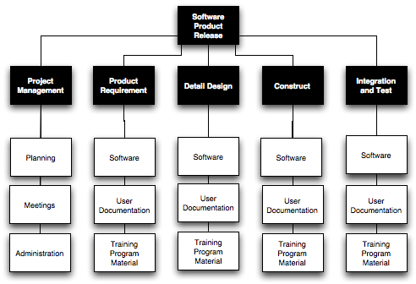

Slide 12
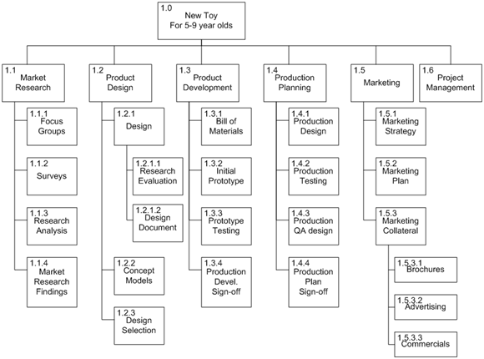

Slide 13
Purpose of a Task Network
Also called an activity network
It is a graphic representation of the task flow for a project
It depicts task length, sequence, concurrency, and dependency
Points out inter-task dependencies to help the manager ensure continuous progress toward project completion
The critical path
A single path leading from start to finish in a task network
It contains the sequence of tasks that must be completed on schedule if the project as a whole is to be completed on schedule
It also determines the minimum duration of the project

Slide 14
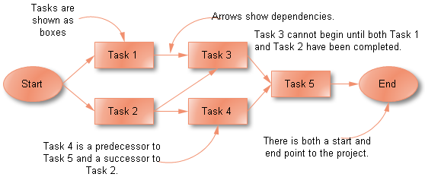

Slide 15
Example Task Network
Task F
2
Task G
3
Task H
5
Task B
3
Task N
2
Task A
3
Task C
7
Task E
8
Task I
4
Task J
5
Task M
0
Task D
5
Task K
3
Task L
10
Where is the critical path and what tasks are on it?

Slide 16
Example Task Network with Critical Path Marked
Task F
2
Task G
3
Task H
5
Task B
3
Task N
2
Task A
3
Task C
7
Task E
8
Task I
4
Task J
5
Task M
0
Task D
5
Task K
3
Task L
10
Critical path: A-B-C-E-K-L-M-N

Slide 17
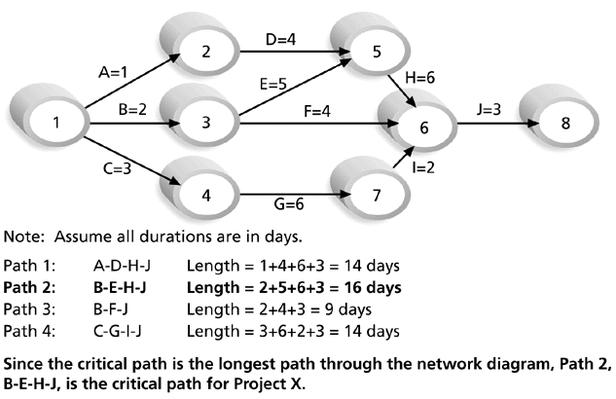
Determining the Critical Path for Project X

Slide 18
Timeline Chart

Slide 19
Mechanics of a Timeline Chart
Also called a Gantt chart; invented by Henry Gantt, industrial engineer, 1917
All project tasks are listed in the far left column
The next few columns may list the following for each task:
projected start date
projected stop date
projected duration
actual start date
actual stop date
actual duration
task inter-dependencies (i.e., predecessors)‏

Slide 20
Mechanics of a Timeline Chart
To the far right are columns representing dates on a calendar
The length of a horizontal bar on the calendar indicates the duration of the task
When multiple bars occur at the same time interval on the calendar, this implies task concurrency
A diamond in the calendar area of a specific task indicates that the task is a milestone; a milestone has a time duration of zero
Jan Feb Mar Apr May Jun Jul Aug Sep Oct
Task #
Task Name
Duration
Start
Finish
Pred.
1
Task A
2 months
1/1
2/28
None
2
Milestone N
0
3/1
3/1
1

